Slide 1
BENCHMARK SPARKLE ON RISC-V SOFTCORE ARCHITECTURES

Slide 2
Deliverables
Documentation
Performance Data
Code
Demo

Slide 3
WHAT IS SPARKLE?​
Permutation functions used in crypto algorithms​
Performs Additon-Rotation-XOR (ARX)​
Basis for 2 standardized constructions:​
SCHWAEM (AEAD encryption)​
ESCH (Hash function)

Slide 4
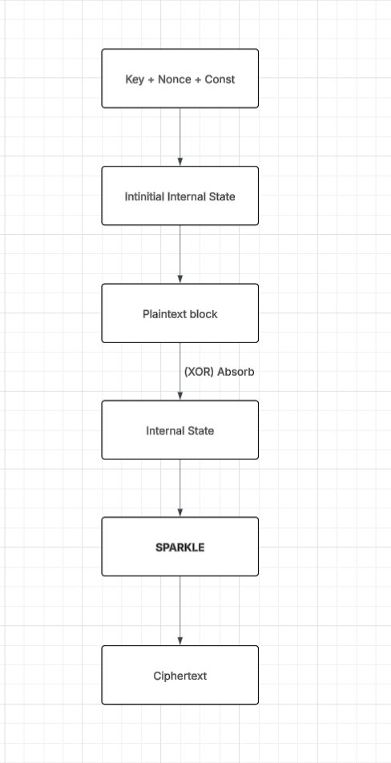
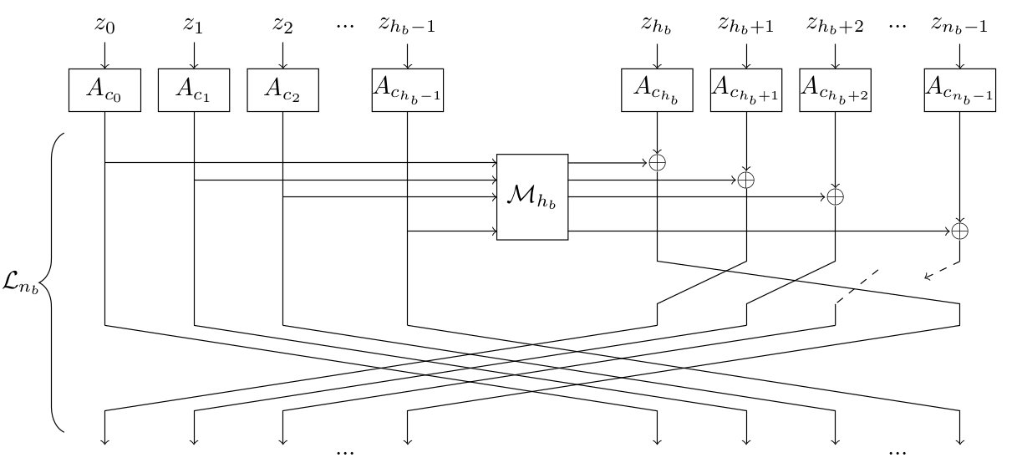
EXAMPLE OF AEAD + SPARKLE​

Slide 5
WHY SPARKLE?
Lightweight & Efficient:​
Small code size​
Low RAM usage​
Fast in microcontrollers​
ARX design (No S-boxes)​
Addition modulo 2ⁿ​
Rotation​
XOR
It is ideal for embedded and IoT devices needing AEAD (SCHWAEM) or hashing (ESCH).​
Wanted to implement on FPGA​

Slide 6
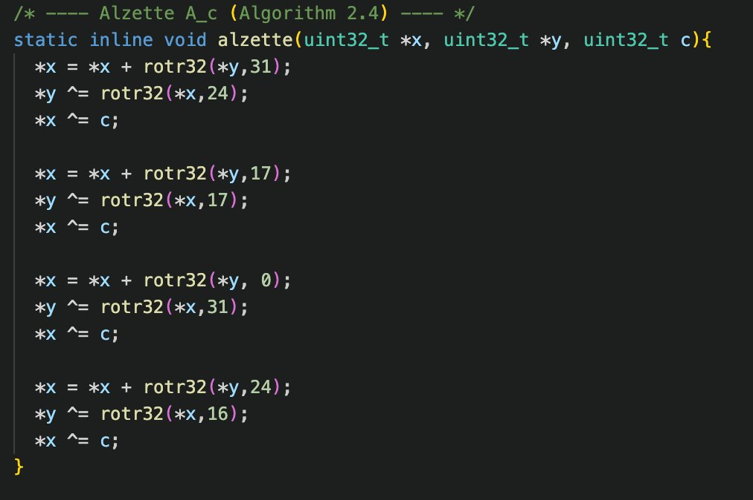
SPARKLE CORE
Shows ARX mixing function X 4

Slide 7
RISC-V SOFTCORE ARCHITECTURES​
Initial goals for softcore Architectures:​
PicoRV32​
VEX​
NeoRV32​
Final Implementations on:​
PicoRV32​
Vex

Slide 8
WHY THESE ARCHITECTURES?​
Features​ | PicoRV32​ | VexRiscv​ | NeoRV32​
Defining Features | Smallest, simplest core​ | High performance + configurable​ | Educational MCU core​
Pipeline​ | No pipeline​ | Configurable (1-5 stage)​ | 2-3 Stage​
FPGA Size​ | Tiny ​ | Scale from small -> large​ | Medium​
Speed​ | Moderate​ | Very fast​ | Good​
Custom Instruction​ | Easiest​ | Very flexible​ | Supported​
Documentation​ | Simple​ | Good​ | Excellent​
Use Case​ | Small SoCs, accelerators​ | Linux SoC, research, customization​ | Teaching, MCU application​

Slide 9
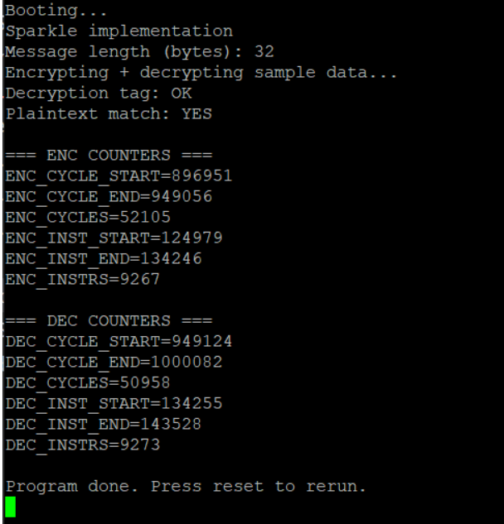
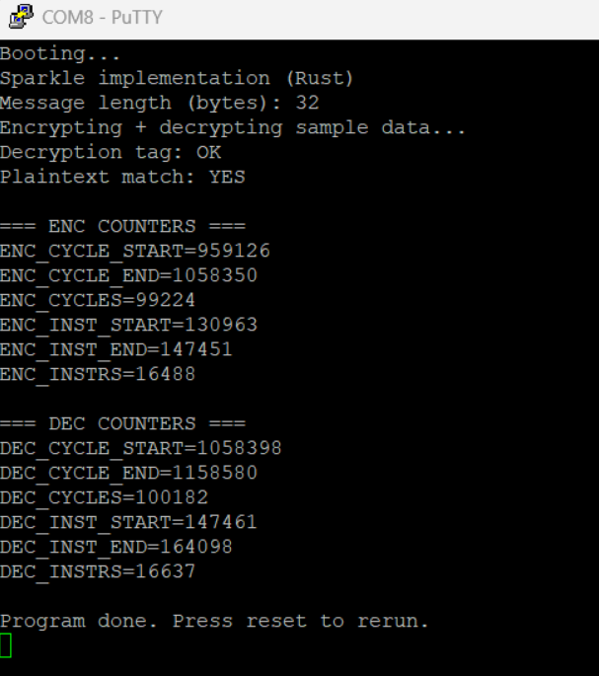
Results
Sparkle – PicoRV32 (C)
Sparkle – PicoRV32 (Rust)

Slide 10
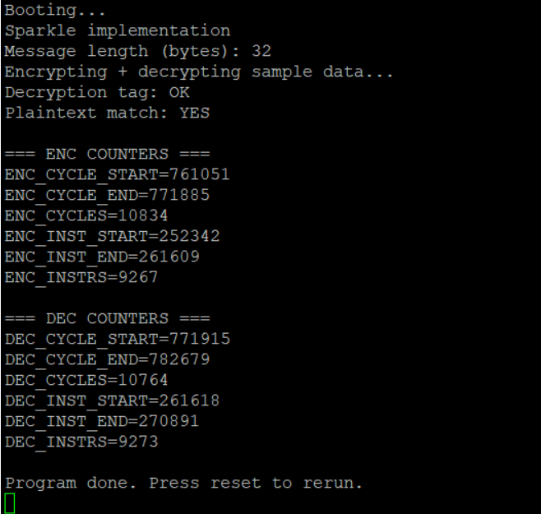
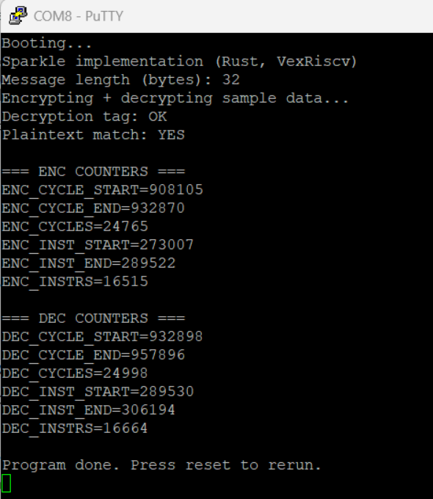
Results
Sparkle – VexRiscV (C)
Sparkle – VexRiscV (Rust)

Slide 11
BENCHMARK RESULTS​
Core | Language | ENC Cycles | DEC Cycles | ENC Instructs | DEC Instructs
PicoRV32 | C | 52,105 | 50,958 | 9,267 | 9,273
PicoRV32 | Rust | 99,224 | 100,182 | 16,488 | 16,637
VexRiscV | C | 10,834 | 10,764 | 9,267 | 9,273
VexRiscV | Rust | 24,765 | 24,998 | 16,515 | 16,664

Slide 12
Demo

Slide 13
Problems encountered
Cross Compilation took a very long time to set up for Rust
Figuring out the implementation of softcores on FPGA was complex

Slide 14
Conclusion
Schwaemm128 is efficiently implementable on RISC-V soft-cores, even minimal ones like PicoRV32.
VexRiscv delivers significantly better performance, running ~4–5× faster due to pipelining and architectural optimizations.
Rust introduces roughly double the instruction count and runtime, consistent with both compiler overhead and code generation choices.

